Slide 1
Android

Slide 2
Workshop Outline
Lesson 1: Lesson 1: Introduction to Android
History
Version History
Android Installation and Preparation
Lesson 2: My First Android App
Eclipse IDE orientation
Intro to perspectives
MVC paradigm
”Hello World”
Lesson 3: Basic Control and Listeners
Lesson 4: Lists and Alert Dialogs

Slide 3
Outline
Lesson 5: Intents
Implicit
Explicit
Lesson 6: Options and Context Menus
Lesson 7: Localization
Lesson 8: Database
Creating a database
Adding data
Showing data
Deleting Data
Updating Data

Slide 4
Outline
Lesson 9: XML Layouts
Linear
Relative
Frame
ListView
Lesson 10: Service and Backgrounds
Lesson 11: Security and permission
Lesson 13: Debugging
Eclipse IDE
Debugger perspective
LOGCAT
profiling

Slide 5
Lesson 14: Content Providers
Lesson 15 : Broadcast Receivers
Lesson 16: Basic Animation and Media via View API
Lesson 17: Games via SurfaceView API
Lesson 18: Communication SMS/ WIFI
Lesson 19: Using/Creating libraries and 3rd Party API'S
Lesson 20: Publishing your App

Slide 6
Android Framework and App overview
Installation and Tools
Application Class, Manifest and Context,
Activities
Layouts and Views
Fragments
Intents and Preferences
Services
SQLite Implementations
Content Providers
Broadcast Receivers
Using/Creating libraries and 3rd Party API'S

Slide 7
History of Android
In July 2005, Google acquired Android, Inc., a small startup company based in Palo Alto, California, USA.
Android's cofounders went to work at Google
Andy Rubin (co-founder of Danger)
Rich Miner (co-founder of Wildfire Communications)
Nick Sears (once VP at T-Mobile)
Chris White (WebTV)
Goal was to develop an Open Source O.S. for the mobile device. (smartphone)
Currently there are approx. 3 billion activated droid units
Companies build up the O.S by its O.H.A

Slide 8
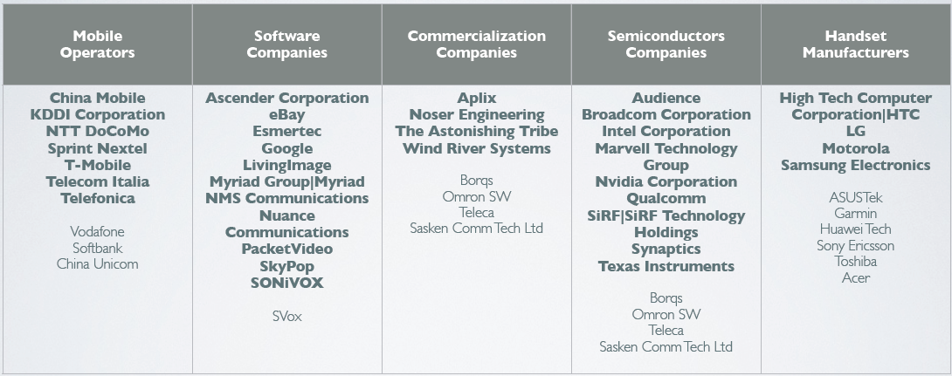
Open Handset Alliance

Slide 9
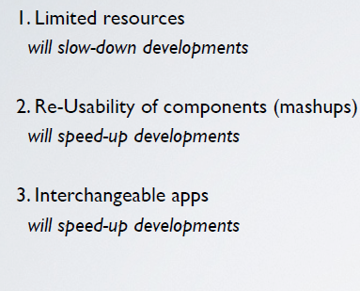
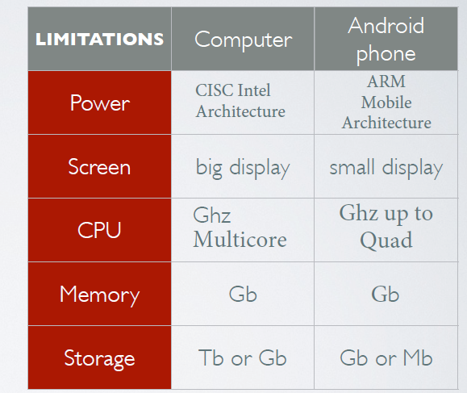
Droid vs traditional devt.

Slide 10
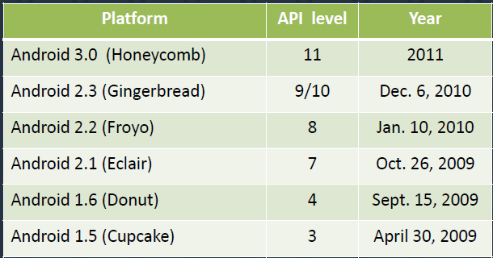
Android Versions

Slide 11
What is Android
Software stack for mobile device (Operating system(0.S),
Middleware, and key application)
• Android O.S based on linux kernel and world’s best selling
• Large Community of Developers writing application(“apps”)
• The Android open-source software stack consists of Java
applications running on a Java-based,
object-oriented application framework
• each version is developed under a code name based on
a dessert item. The code names are in alphabetical order, as
seen by Cupcake, Donut, Eclair, Froyo, Gingerbread,
Honeycomb… JellyBean.
• “cheap and easy” is a benefit, it’s with mobile development. The
Android SDK and tools are freely available on the Android
developer website, http://developer.android.com

Slide 12
What can Android Do?
• highly customizable and therefore can be altered to fit your
tastes and needs.
• Android is the fact that it automatically backs up your
contacts for you.
FEATURES
• Application framework enabling reuse and replacement of components
• Dalvik virtual machine optimized for mobile devices
• Integrated browser based on the open source WebKit engine
• Optimized graphics powered by a custom 2D graphics library; 3D graphics
based on the OpenGL ES 1.0 specification (hardware acceleration optional)
• SQLite for structured data storage
• Media support for common audio, video, and still image formats (MPEG4,
H.264, MP3, AAC, AMR, JPG, PNG, GIF)
New Features
Sensor Fusion --- Gear API
Android Bean (NFC tech.)

Slide 13
What can Android do?
GSM Telephony (hardware dependent)
• Bluetooth, EDGE, 3G, and WiFi (hardware dependent)
• Camera, GPS, compass, and accelerometer (hardware dependent)
• Rich development environment including a device emulator, tools for
debugging, memory and performance profiling, and a plugin for the Eclipse
IDE

Slide 14
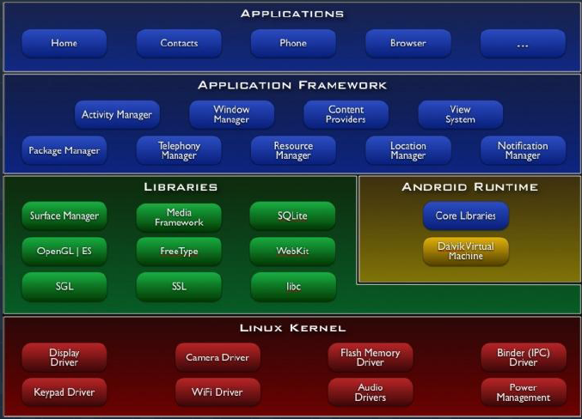
Android Architecture

Slide 15

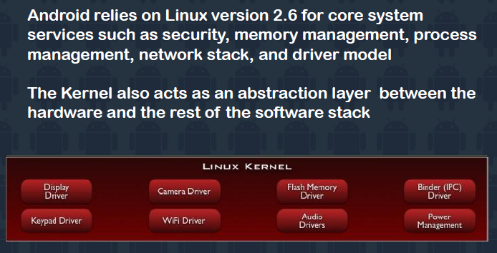
Linux Kernel

Slide 16
Runtime
Every android application runs in its own process, with its own instance of the Dalvik virtual machine
Dalvik has been written so that a device can run multiple VM’s efficiently. The Dalvik VM executes files in the Dalvik executable (.dex) format which is optimized for minimal memory footprint
The VM is register-based, and runs classes compiled in a Java language compiler that have been transformed into the .dex format by the included “dx” tool
The Dalvik VM relies on the Linux kernel for underlying functionality such as threading and low-level memory management

Slide 17
Libraries
Android includes a set of C/C++ libraries used by various components of the Android system:
System C library - a BSD-derived implementation of the standard C system library (libc), tuned for embedded Linux-based devices
Media Libraries - based on PacketVideo's OpenCORE; the libraries support playback and recording of many popular audio and video formats, as well as static image files, including MPEG4, H.264, MP3, AAC, AMR, JPG, and PNG
Surface Manager – manages access to the display system and seamlessly composites 2D and 3D graphic layers from multiple applications

Slide 18
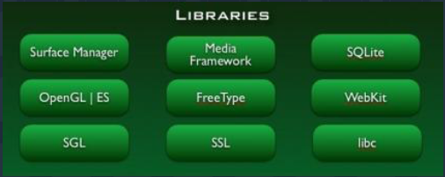
Libraries
Media Libraries – support playback and recording of popular
audio and video formats, as well as static image files
FreeType – bitmap and vector font rendering
WebKit – layout engine designed to allow web browsers to
render webpages

Slide 19
App Framework
Android ships with a set of core applications including an email client, SMS program, calendar, maps, browser, and others. All applications are written in Java
Underlying all applications is a set of services and systems including:
A rich and extensible set of Views that can be used to build an application, including lists, grids, text boxes, buttons, and even an embeddable web browser
Content Providers that enable applications to access data from other applications (such as Contacts), or to share their own data

Slide 20
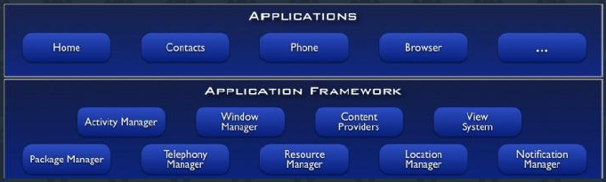
App Framework
A Resource Manager, providing access to non-code resources such as localized strings, graphics, and layout files
A Notification Manager that enables all applications to display custom alerts in the status bar
An Activity Manager that manages the lifecycle of applications and provides a common navigation backstack

Slide 21
Exploring the Android System
Android ships with a set of core applications including SMS program, calendar, maps, browser, contacts, email clients and others. All applications are written using the Java programming language.
The following slides will show your way around the Android system as users see it and list some important features of Android.

Slide 22
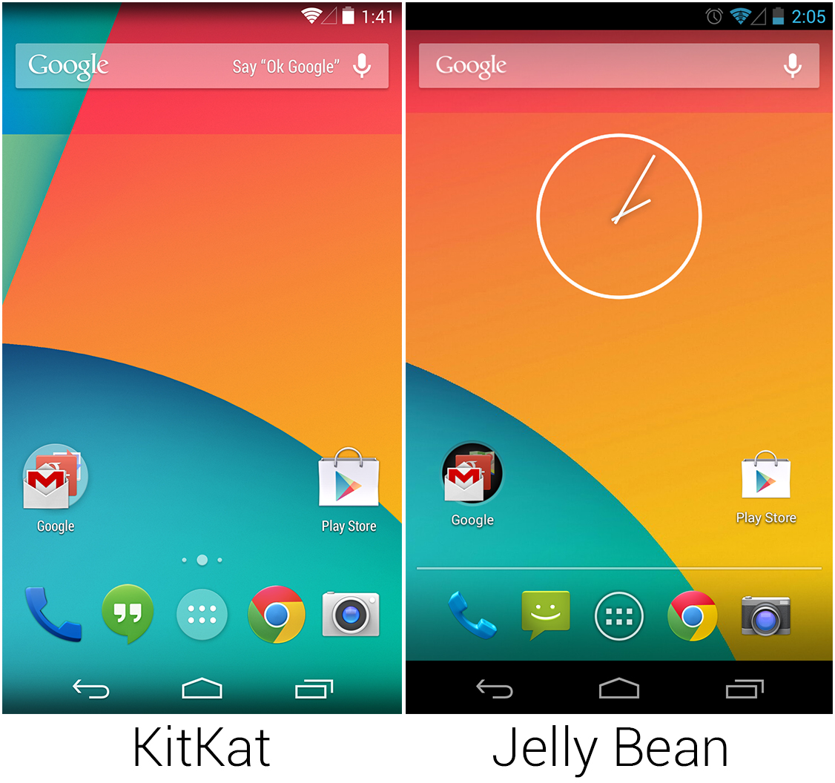
Home Screen

Slide 23
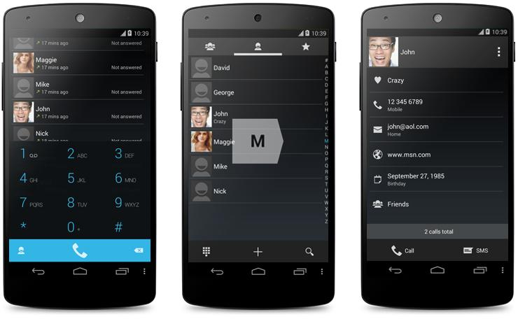
Dialer Application

Slide 24
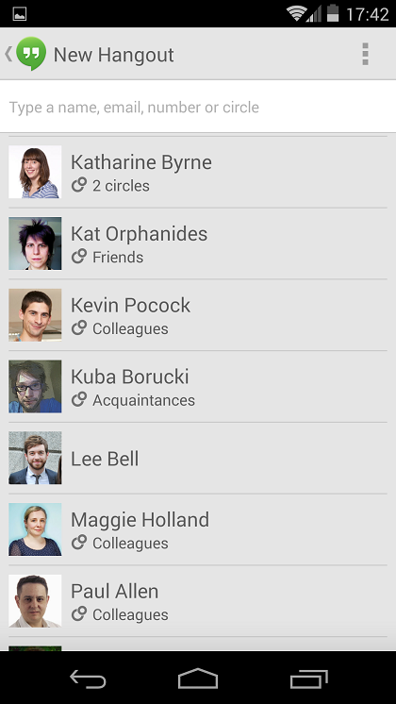
Contacts App

Slide 25
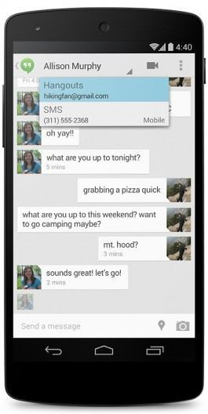
Messaging

Slide 26
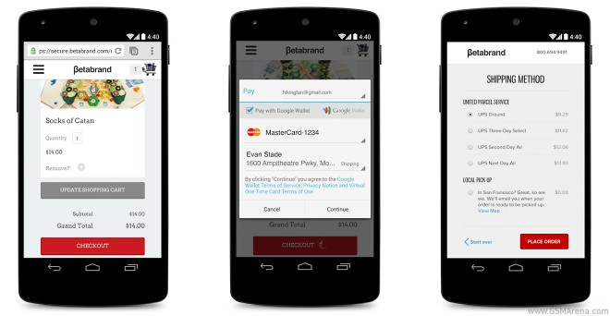
Browser Application

Slide 27
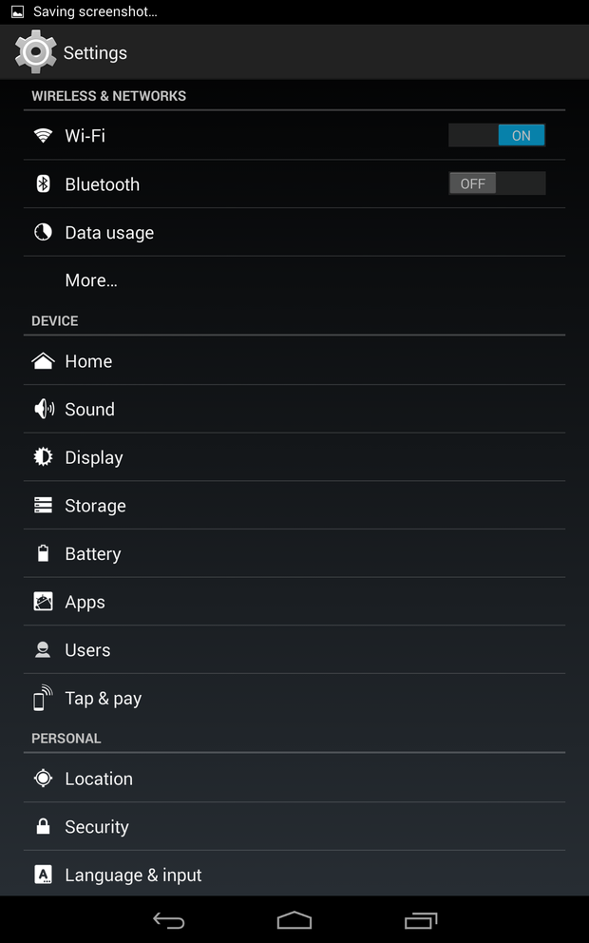
Settings Application

Slide 28
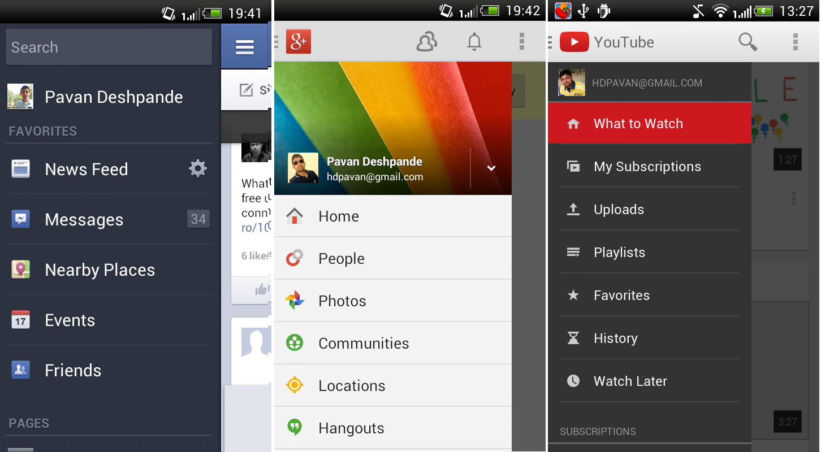
App Sliding Drawer

Slide 29
Android Installation and Preparation
4 download and install steps:
Java SDK
http://developers.sun.com/downloads/
Eclipse
http://www.eclipse.org/downloads/
Android SDK
http://developer.android.com/sdk/index.html
ADT
https://dl-ssl.google.com/android/eclipse

Slide 30
Adding Android to your system Path
MAC OS
go in your home directory
edit (or create) .bash_profile
add the complete path to tools in the PATH variable (coma separated)
example: export PATH=${PATH}:/Developer/android-sdk-mac_86/tools/
GNU/LINUX
go in your home directory
edit .bash_profile or .bash_rc
add the complete path to tools in the PATH variable (coma separated)
example: export PATH=${PATH}:/Developer/android-sdk-mac_86/tools/
WINDOWS
Explorer - right click on My Computer - click on Properties - click on Advanced tab - click on Environment variable - double click on PATH - adding the path to tools in the variable

Slide 31
Lesson 2
Building Your First Android Application

Slide 32
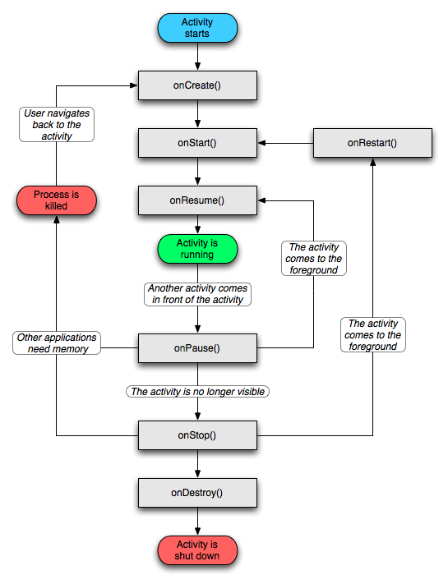
App LifeCycle

Slide 33
Creating a new Project
1. Choose File, New, Android Project or click the Android Project creator icon, which looks like a folder (with the letter a and a plus sign:) on the Eclipse toolbar.
2. Choose a project name. In this case, name the project “My First Droid App”
3. Choose a location for the project. Because this is a new project, select the Create New Project in Workspace radio button. Check the Use Default Location check box.

Slide 34
4. Select a build target for your application. For most applications, you want to select the version of Android most appropriate for the devices used by your target audience and the needs of your application. If you will be using the Google add-ons (for example, Google Maps), be sure to choose the Google APIs version for your target platform. For this example, the Android 2.3.1 (API level 9) build target is sufficient.
5. Specify an application name. This name is what users will see. In this case, call the application Android App.
6. Specify a package name, following standard package namespace conventions for Java. (e.g. com.androidtribe.*)

Slide 35
7. Check the Create Activity check box. This will instruct the wizard to create a default launch Activity class for the application. Call your activity AndroidActivity01.
8. Confirm that the Min SDK Version field is correct. This field will be set to the API level of the build target by default (Android 2.2 is API level 8). If you want to support older versions of the Android SDK, you need to change this field. However, in this case, we can leave it as its default value.
9. Click the Finish button.

Slide 36
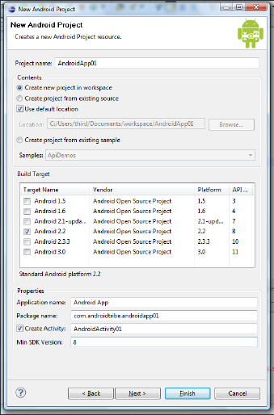
Eclipse IDE

Slide 37
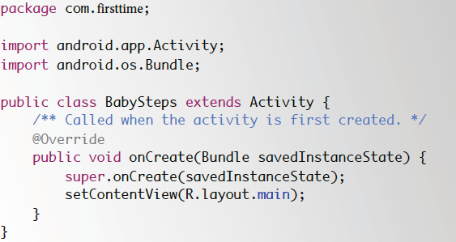
Skeleton template

Slide 38
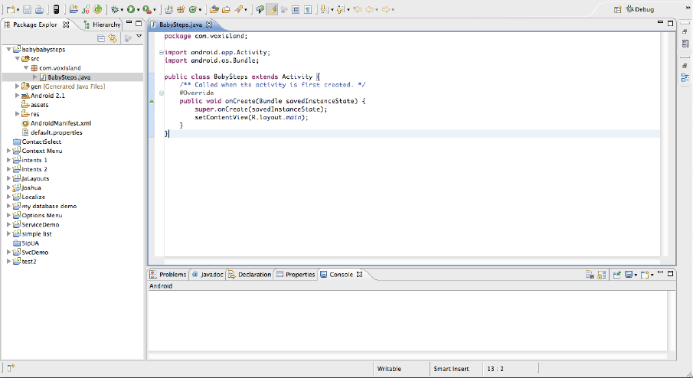
JAVA Perspective

Slide 39
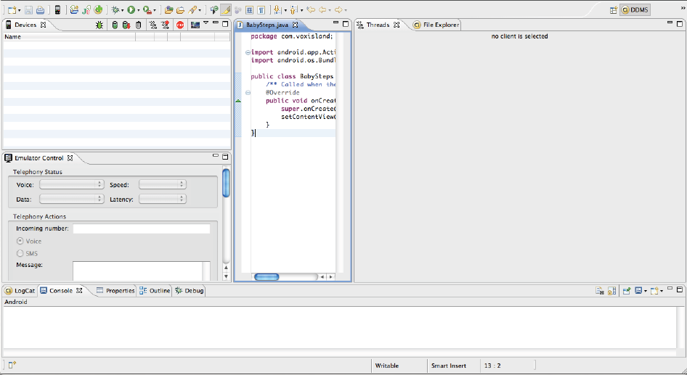
DDMS Perspective

Slide 40
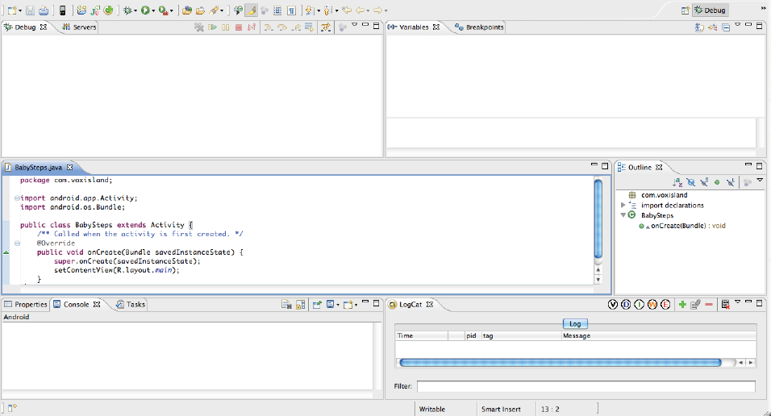
Debug Perspective

Slide 41
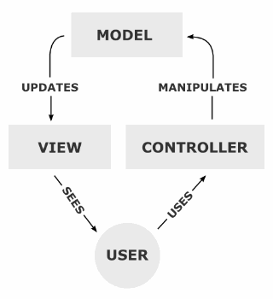
What is MVC
Android SDK development follows the MVC design template.
Model : notifies its associated views and controllers when there has been a change in its state
View : requests from the model the information that it needs to generate an output representation
Controller: send commands to its associated view to change the view's presentation of the model

Slide 42
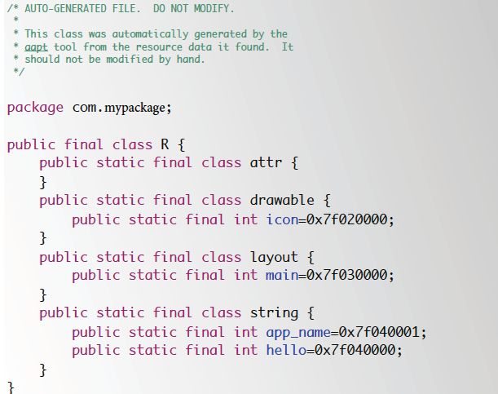
R.Class (Autogenerated)

Slide 43
R.java is the dynamically generated class, created during build process to dynamically identify all assets (from strings to android widgets to layouts), for usage in java classes in Android app. Note this R.java is Android specific (though you may be able to duplicate it for other platforms, its very convenient) so it doesnt have much to do with Java language constructs

Slide 44
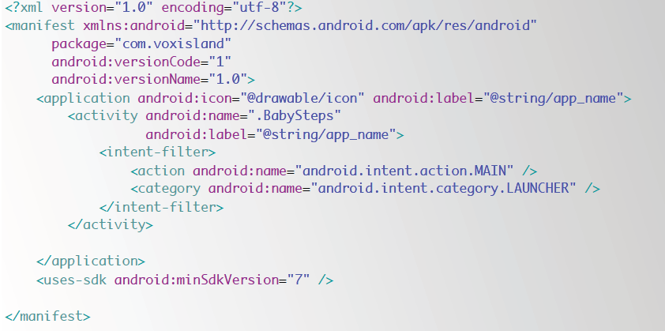
Manifest File .XML

Slide 45
Every application must have an AndroidManifest.xml file (with precisely that name) in its root directory. The manifest file presents essential information about your app to the Android system, information the system must have before it can run any of the app's code. Among other things, the manifest does the following:

Slide 46
It names the Java package for the application. The package name serves as a unique identifier for the application.
It describes the components of the application — the activities, services, broadcast receivers, and content providers that the application is composed of. It names the classes that implement each of the components and publishes their capabilities (for example, which Intent messages they can handle). These declarations let the Android system know what the components are and under what conditions they can be launched.

Slide 47
It determines which processes will host application components.
It declares which permissions the application must have in order to access protected parts of the API and interact with other applications.
It also declares the permissions that others are required to have in order to interact with the application's components.

Slide 48
It lists the Instrumentation classes that provide profiling and other information as the application is running. These declarations are present in the manifest only while the application is being developed and tested; they're removed before the application is published.
It declares the minimum level of the Android API that the application requires. It lists the libraries that the application must be linked against.

Slide 49
<action> <activity> <activity-alias> <application> <category> <data> <grant-uri-permission> <instrumentation> <intent-filter> <manifest> <meta-data> <permission> <permission-group> <permission-tree> <provider> <receiver> <service> <supports-screens> <uses-configuration> <uses-feature> <uses-library> <uses-permission> <uses-sdk>

Slide 50
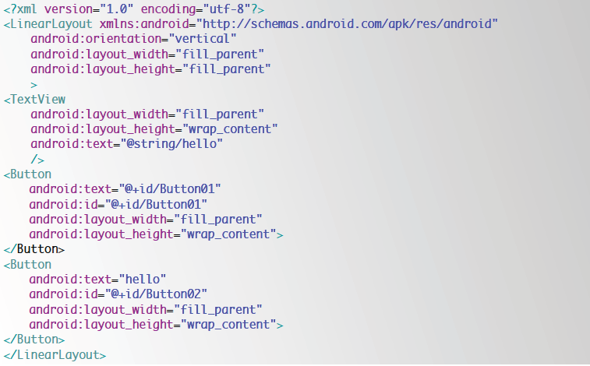
main.xml

Slide 51
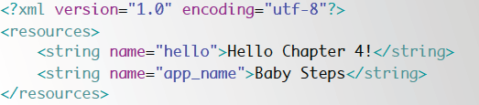
Strings. XML

Slide 52
Rules:
Follow Java Coding Guidelines
Resource (res) folder files must be named all in lowercase letters.
XML files should always be android XML files
Gen folder must not be touched
Always save code to let eclipse check for errors (ctrl+shift+s)
For code template suggestions, press ctrl+space
For import resolutions press ctrl+shift+o
Be open minded about MVC even if its very complex!!!!

Slide 53
Lesson 3
Basic Control and Listeners

Slide 54
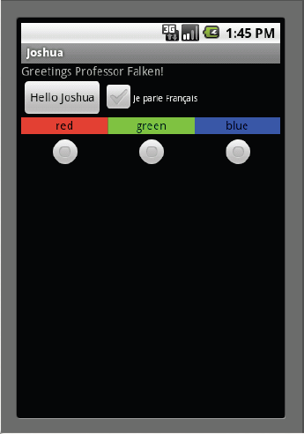
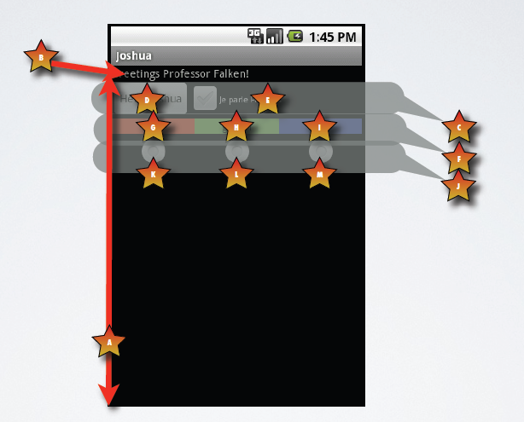
Basic UI Guide

Slide 55
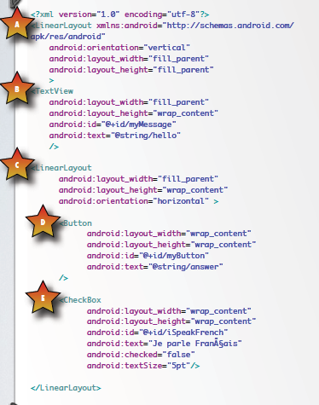

Slide 56
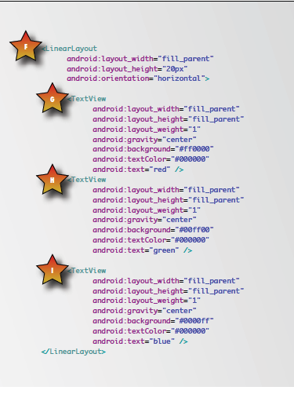

Slide 57
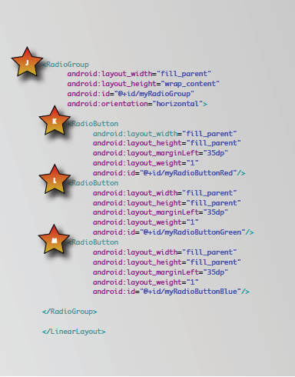

Slide 58
Go to the java file
Create the following widget references:
On the OnCreate method, refer the widgets to its proper ID
Button b;
TextView tv;
OnClickListener radiolisten;
RadioButton red,green,blue;
CheckBox cb;
tv=(TextView)findViewById(R.id.tv1);
b=(Button)findViewById(R.id.button1);
red=(RadioButton)findViewById(R.id.radiored);
green=(RadioButton)findViewById(R.id.radiogreen);
blue=(RadioButton)findViewById(R.id.radioblue);

Slide 59
Event Listeners
There are many ways for widgets to listen to events.
Listeners respond to interfaces that must be implemented in a manner of anonymous coding upon setting a widgets listener
An event handling method returns a View that is responsible for the call of the said event

Slide 60
OnClickListener onclick=new OnClickListener(){
public void onClick(View arg0) {
// TODO Auto-generated method stub
Button f=(Button)arg0;
if(f.getId()==R.id.button1)
{
tv.setText("Hello Again");
b.setText("this has been changed");
if(cb.isChecked())
Toast.makeText(arg0.getContext(),"The tides have been checked",Toast.LENGTH_SHORT).show();
else
Toast.makeText(arg0.getContext(),"this is okay",Toast.LENGTH_SHORT).show();
}
}};
b.setOnClickListener(onclick);

Slide 61
Short Version
Eclipse Intellisense features does warn you of unimplemented codes..
cb=(CheckBox)findViewById(R.id.checkbox1);
cb.setOnClickListener(new View.OnClickListener() {
public void onClick(View v) {
CheckBox dat=(CheckBox)v;
if(dat.isChecked())
b.setText("HI THERE");
else
b.setText("OKAY THEN");
}
});

Slide 62
Toast
Used as a message box to show information in a given time period
Very useful for info checking
Good for debugging purpose
Programmer usually forgets the .show() part….
Toast.makeText(getApplicationContext(),
“this is the text shown",
Toast.LENGTH_SHORT).show();

Slide 63
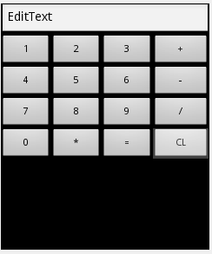
TRY THIS
Make a calculator program that can do basic calculator functions
For beginners, use the drag and drop features…
But.. Its better to type the xml code..

Slide 64
Lesson 4
List and Alert Dialogs

Slide 65
List
A widget that displays a list of Choices
Useful on displaying
Options
Names
Choices
When using List, the class must extend to a ListActivity
XML layout is not needed:

Slide 66
In order to display items on the List, an array of strings is needed: (page 52 of the program guide)
String[] firstNames = {
"Abigail", "Alexander", "Alexis", "Alyssa", "Andrew", "Anna", "Anthony", "Ashley",
"Austin", "Ava", "Benjamin", "Brandon", "Brianna", "Caleb", "Chloe", "Christian",
"Christopher", "Daniel", "David", "Destiny", "Dylan", "Elijah", "Elizabeth", "Emma",
"Ethan", "Gabriel", "Grace", "Hailey", "Hannah", "Isabella", "James", "Jasmine",
"Jennifer", "Jessica", "John", "Jonathan", "Jose", "Joseph", "Joshua", "Julia",
"Justin", "Kaitlyn", "Katherine", "Kayla", "Kevin", "Lauren", "Logan", "Madison",
"Matthew", "Megan", "Mia", "Michael", "Morgan", "Natalie", "Nathan", "Nicholas",
"Noah", "Olivia", "Rachel", "Robert", "Ryan", "Samantha", "Samuel", "Sarah",
"Sophia", "Sydney", "Taylor", "Thomas", "Tyler", "Victoria", "William", "Zachary"
};

Slide 67
Create an ArrayAdapter<String> to convert (cast) if you will the strings in the array into string items on the list:
Use setListAdapter to set the ArrayAdapter on the List
adapter=new ArrayAdapter<String>(this, android.R.layout.simple_list_item_1,
myList);
setListAdapter(adapter);

Slide 68
List Listeners
Use the OnItemClickListener() to listen to items chosen on the list
Ex. OnItenmClickListener itemclick;
itemclick=new OnItemClickListener(){
public void onItemClick(AdapterView<?> parent, View arg1, int index,long arg3) {
Toast.makeText(getApplicationContext(),"HI"+parent.getItemAtPosition(index),Toast.LENGTH_LONG).show();
}};

Slide 69
ArrayList
ArrayAdapters mostly deals with casting string objects as itmes on the list.
It is highly recommended to convert String array of items into an ArrayList which makes string objects usable
Ex:
ArrayList<String> alist;
alist=new ArrayList<String>(Arrays.asList(myarray));
adapter=new ArrayAdapter<String>(this,android.R.layout.simple_list_item_1,alist);

Slide 70
OnItemLongClickListener
This listener responds to long tap gestures on the screen
OnItemLongClickListener itemListener;
itemListener=new OnItemLongClickListener(){
public boolean onItemLongClick(AdapterView<?> parent, View arg1, int index, long arg3) {
Toast.makeText(context.getApplicationContext(),“Long"+ parent.getItemAtPosition(index),Toast.LENGTH_LONG).show();
}};

Slide 71
Lesson 4
Alert Dialogs

Slide 72
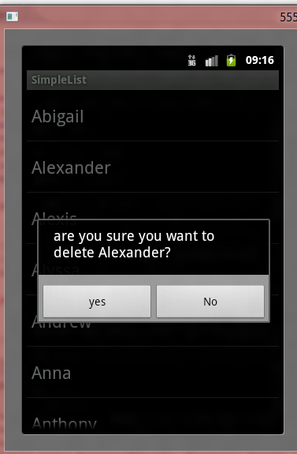
AlertDialog
An Object that displays a dialog box
Useful for prompt warnings and verification
Message
Positive button
Negative Button

Slide 73
AlertDialog.Builder dialog =new AlertDialog.Builder(context);
dialog.setMessage("are you sure you want to delete "+itemselected+"?");
dialog.setCancelable(false);
dialog.setPositiveButton("yes",new DialogInterface.OnClickListener() {
public void onClick(DialogInterface arg0, int arg1) {
adapter.remove(itemselected);
adapter.notifyDataSetChanged(); // tell the view to refresh the list
}
});
dialog.setNegativeButton("No",new DialogInterface.OnClickListener() {
public void onClick(DialogInterface arg0, int arg1) {
// TODO Auto-generated method stub
arg0.cancel(); // cancel the builder
}
});

Slide 74
Lesson 5
Intents

Slide 75
What is an Intent
An action of enabling a process Thread passing current context and View.
An Intent may be a service, broadcast or Activity class
A Bundle (optional) is sent to the enabled intent
Two types
Implicit = called upon intents in the O.S.
Explicit = called upon customized intents built by the developer

Slide 76
Intents
When an intent is called, there are two requirements needed to enable the intent:
Action = type of intent action
Usually in the for of static action values
Ex: Intent.ACTION_VIEW
Data = resource used to process in action
In the form of URI
android.provider.MediaStore.Images.Media.INTERNAL_CONTENT_URI
Uri.parse("sms:\09154098011")
List of shortcuts of Uri found on http://www.openintents.org/en/intentsbigtable

Slide 77
Implicit Intent
Intent I =new Intent();
i.setAction(Intent.ACTION_VIEW); // activity to view specified data
i.setData(android.provider.MediaStore.Images.Media.INTERNAL_CONTENT_URI);
startActivity(i);

Slide 78
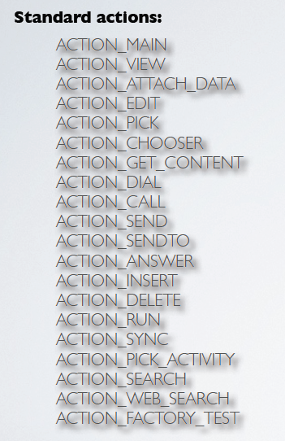

Slide 79
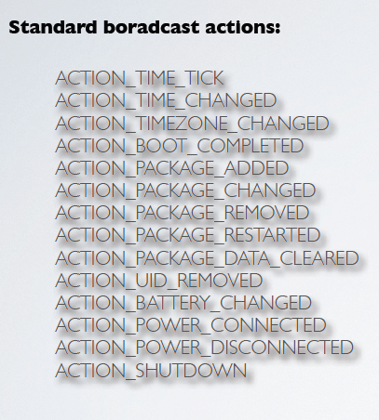

Slide 80
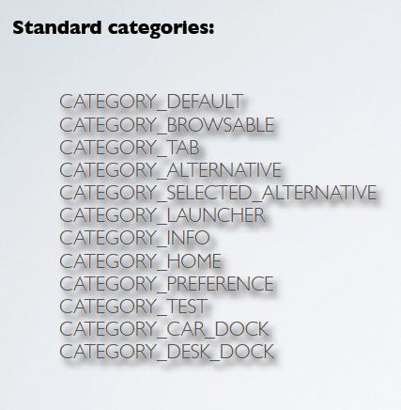

Slide 81
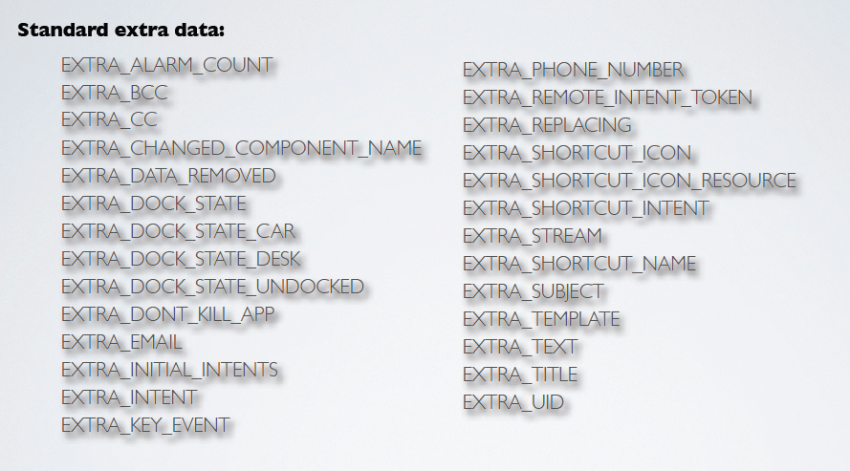

Slide 82
Explicit Intents
Customized Activity called by another
Data can be passed to and from the intent via bundles
Bundle
Collection object that acts like a hash (contains a key and data)

Slide 83
Putting data to an intent using Bundle
Intent i=new Intent(getApplicationContext(),SecondAct.class);
Bundle b=new Bundle();
b.putString("text2","sadfasdfsd");
i.putExtras(b);
startActivityForResult(i,0);

Slide 84
Shortcut version
Intent i=new Intent(getApplicationContext(),
SecondAct.class);
i.putExtra("text","hello");
startActivityForResult(i,0);
intent request code

Slide 85
Receiving from intent caller (using Bundle)
Intent i=this.getIntent();
Bundle bi=i.getExtras();
String data=(String)bi.get("text2");
WITH OUT BUNDLE
String data= i.getStringExtra("text2");

Slide 86
Sending data back to caller
i=getIntent();
i.putExtra("back","hi");
setResult(RESULT_OK, i);
finish(); // returns to the calling activity

Slide 87
Accepting data from returning intent
@Override
protected void onActivityResult(int requestCode, int resultCode, Intent data) {
if(requestCode==0 && resultCode== RESULT_OK){
String str=data.getExtra().getString("back").toString();
b.setText(str);
}
super.onActivityResult(requestCode, resultCode, data);
}

Slide 88
Lesson 6
Options and Context Menus

Slide 89
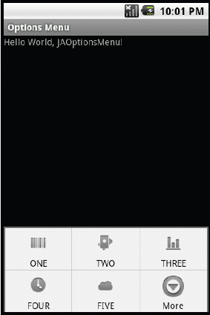
Options Menu
When pressing the menu hardkey button, the options menu is displayed.
These can be customized to you app.

Slide 90
How?
Override the onCreateOptionsMenu method
Add menu items
label group index order
menu.add(0, Menu.FIRST, Menu.NONE, "ONE").setIcon(R.drawable.barcode);
image icon (64X64 pixels)

Slide 91
To listen to menu items clicked
Override the onOptionsItemSelected method.
public boolean onOptionsItemSelected(MenuItem item) {
TextView tv = (TextView)findViewById(R.id.tv);
tv.setText(“pressed #"+String.valueOf(item.getItemId()));
return true;
}

Slide 92
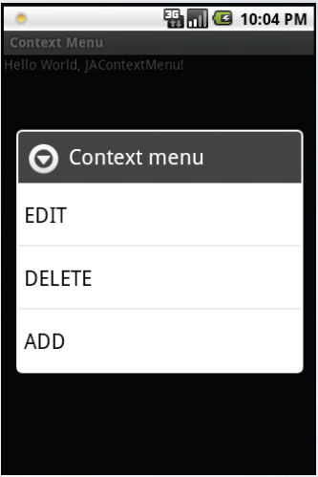
Context menu
Displayed when the user holds down on the screen, a menu is displayed as a small list

Slide 93
How
Override the onCreateContextMenu method
Add menu items
menu.add(0, Menu.FIRST, Menu.NONE, "EDIT");

Slide 94
To listen to menu items clicked
Override the onContextItemSelected method
@Override
public boolean onContextItemSelected(MenuItem item) {
Toast.makeText(getApplicationContext(), item.getTitle().toString(), Toast.LENGTH_SHORT).show();
return true;

Slide 95
Lesson 7
Localization

Slide 96
What to do
1. Design your application
2. Choose your localization strategy: which countries, which languages?
3. Use no hard-coded strings or string constants; use R.string and strings.xml files.
4. Use no hard-coded drawables or layouts; use R.drawable and R.layout
5. Translate your strings files; localize your drawables.
6. Place your localized resources in the appropriate directories under 'res/'.
7. Create your final build or builds, using 'aapt' as necessary.
8. Upload your .apk file or files to Market, selecting the appropriate languages as you upload.

Slide 97
Country symbols
Locale Code | Language/Country | Location of Strings | Location of Images
default | default | res/values/ | res/drawable/
en-rUS | US | res/values/ | res/drawable-en-rUS /
fr-rFR | France | res/values-fr/ | res/drawable-fr-rFR /
en-rCA | English/Canada | res/values/ | res/drawable-en-rCA/
fr-rCA | French/Canada | res/values-fr/ | res/drawable-fr-rCA/
tl-rPH | Philippines | res/values-tl/ | res/drawable-tl-rPH/

Slide 98
Lesson 8
Database

Slide 99
Database Library
Android provides full relational database capabilities
Uses SQLite libraries
Object c based and standard query tags apply
No straight type checking
By default database data is private (only the creating app may access it)
The database returns results as Cursors :
Cursors are objects that point and fetch data.
Database name and creation tags must be final and static

Slide 100
Database name
private static final String DATABASE_NAME = "JADB.db";
private static final String DATABASE_TABLE = "myTable";
private static final String DATABASE_CREATE = "create table "+DATABASE_TABLE+" (_id integer
primary key autoincrement, col1 text not null);";

Slide 101
Creating a DataBase
SQLiteDatabase myDB;
myDB = openOrCreateDatabase(DATABASE_NAME, Context.MODE_PRIVATE, null);
myDB.execSQL(DATABASE_CREATE);
myDB.close();

Slide 102
Adding Items to the DataBase
SQLiteDatabase myDB;
myDB = openOrCreateDatabase(DATABASE_NAME, Context.MODE_PRIVATE, null);
ContentValues newRow = new ContentValues();
newRow.put("col1", "ok");
myDB.insert(DATABASE_TABLE, null, newRow);
myDB.close();

Slide 103
Counting Number of Row Entries
SQLiteDatabase myDB;
myDB = openOrCreateDatabase(DATABASE_NAME, Context.MODE_PRIVATE, null);
String[] resultColumns = new String[] {"_id", "col1"};
Cursor allRows = myDB.query(DATABASE_TABLE, resultColumns, null, null, null, null, null, null);
Integer c = allRows.getCount();
myDB.close();

Slide 104
query(String table, String[] columns, String selection, String[] selectionArgs, String groupBy, String having, String orderBy, String limit)

Slide 105
Show data from database
SQLiteDatabase myDB;
myDB = openOrCreateDatabase(DATABASE_NAME, Context.MODE_PRIVATE, null);
String[] cresult = new String[] {"_id", "col1"};
Cursor allRows = myDB.query(DATABASE_TABLE, cresult, null, null, null, null, null, null);
String res = "RESULT IS:";
Integer cindex=allRows.getColumnIndex("col1");
if(allRows.moveToFirst()) //checks if data is empty
do{
res+=allRows.getString(cindex)+"->"+allRows.getPosition()+"-";
}while(allRows.moveToNext());
myDB.close();

Slide 106
Deleting a Database item
SQLiteDatabase myDB;
myDB = openOrCreateDatabase(DATABASE_NAME, Context.MODE_PRIVATE, null);
String[] cresult = new String[] {"_id", "col1"};
Cursor allRows = myDB.query(DATABASE_TABLE, cresult, null, null, null, null, null, null);
myDB.delete(DATABASE_TABLE, "_id=1",null);
int c = allRows.getCount();
myDB.close();

Slide 107
Update item on Database
SQLiteDatabase myDB;
myDB = openOrCreateDatabase(DATABASE_NAME, Context.MODE_PRIVATE, null);
String[] cresult = new String[] {"_id", "col1"};
Cursor allRows = myDB.query(DATABASE_TABLE, cresult, null, null, null, null, null, null);
ContentValues newrow=new ContentValues();
newrow.put("col1","changed");
myDB.update(DATABASE_TABLE,newrow,null,null);
int c = allRows.getCount();
myDB.close();

Slide 108
You can use standard query
myDB.rawQuery(sql);
Still returns a Cursor
myDB.execSQL(sql)

Slide 109
Lesson 9
XML Layouts

Slide 110
LinearLayout
LinearLayout: when the order of arrangements of widgets/views of the layout needs to be horizontal or vertical manner, the
LinearLayout widget comes in handy. The direction of arrangement can be set to horizontal or vertical, default being horizontal.

Slide 111
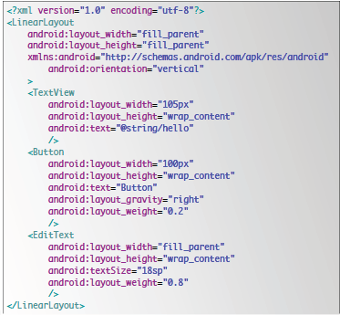
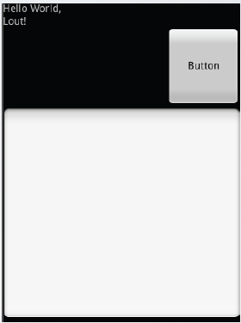
LinearLayout

Slide 112
TableLayout
As the name suggests, this layout object is used when the layout has widgets/views that need to be arranged into rows and columns.
This is similar to html tables. The cells can span columns. The TableLayout do not display its border.
The columns can be made to shrink and stretch by setting the respective properties. TableRow is another helper widget which should be used in conjunction with the TableLayout.

Slide 113
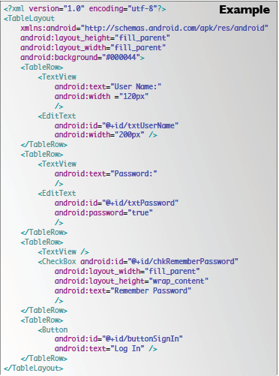
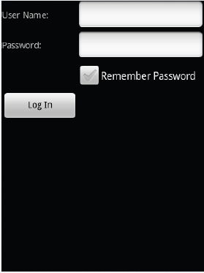
TableLayout

Slide 114
RelativeLayout
when the position of each of the widgets/view is in relative/dependent to each other, then a relative layout is used.
That is for example, when a layout is needed such that it has a text view just to the left of an Edit Textbox, and a button just below the EditText. The relation between the views are taken care in one iteration, hence if view B’s position is dependent on view A’s position, view A must come first in the layout.

Slide 115
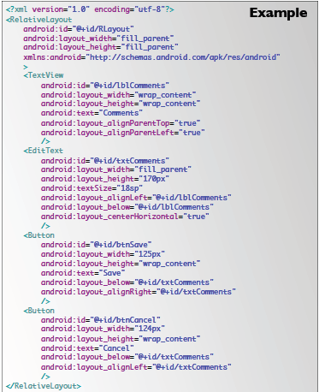
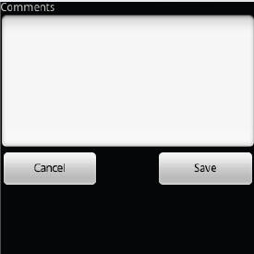
RelativeLayout

Slide 116
FrameLayout
This is a very simple layout which is used to hold a section of the screen blank, for displaying an item or group of items at run time.
All the elements added in the framelayout will be added to the top left of the screen.

Slide 117
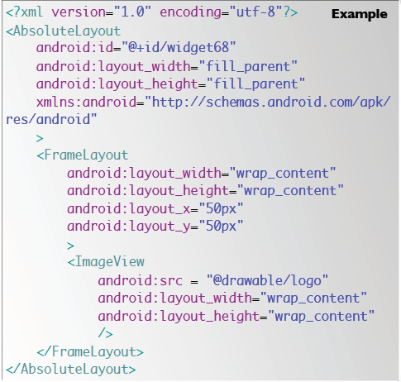
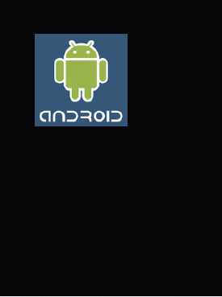
FrameLayout

Slide 118
ListView
used to display list of items in a vertically scrolling list.
ListView has many optimizations that are important for large lists.
ScrollView is used for vertically scrolling in which an infinite amount of space is given to the container to hold all the elements of the view.
A ScrollView should have one child which has the elements to be scrolled.
A ScrollView cannot be used in conjunction with a ListView since the list views optimizations will be nullified in effect.

Slide 119
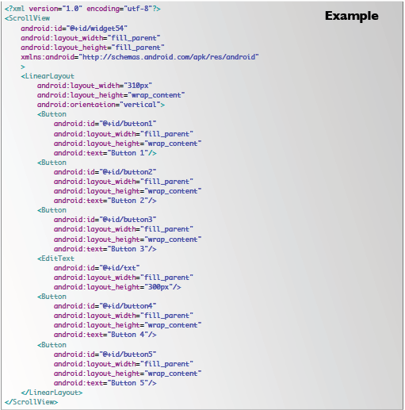
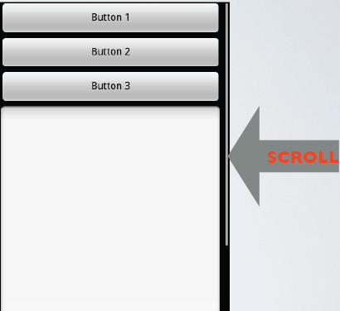
ListView

Slide 120
Lesson 10
Services and Backgrounds

Slide 121
Services
Threads that are called for an activity that run on the background
Two Types:
Unbound = Threads that run indefinitely
Bounded = Run for the lifespan of the calling activity

Slide 122
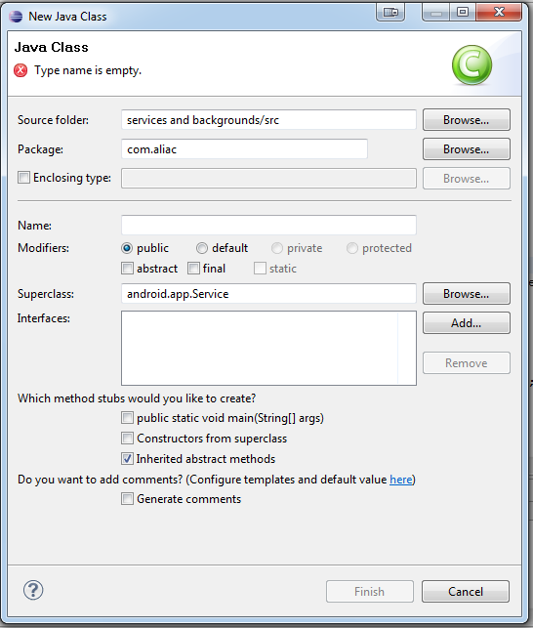
Starting a Service
Create a new Class located on the package
Make sure the Superclass specified is android.app.service
Overide the ff: methods
onCreate()
initialization parameter
onStart()
Code run when service started
onDestroy()
Code run when service stopped

Slide 123
Don’t forget the Manifest
Add the service stub at the manifest
Place stub after activity declaration stubs
<service android:enabled="true" android:name=".TheServiceclassname"/>
<application android:icon="@drawable/icon" android:label="@string/app_name">
<activity android:name=".MyService"
android:label="@string/app_name">
<intent-filter>
<action android:name="android.intent.action.MAIN" />
<category android:name="android.intent.category.LAUNCHER" />
</intent-filter>
</activity>
<service android:enabled="true" android:name=".TheService"/>
</application>
</manifest>

Slide 124
How to control the service
To start the service
startService(new Intent(outercontext,TheService.class));
To Stop the service
stopService(new Intent(outercontext,TheService.class));
Note: outercontext is the current activity context
Advantage:
Any app can start and stop the service as long as the app binds a stub on its manifest

Slide 125
Lesson 11
Security and Permission

Slide 126
There are two types of features for permission security
Requesting permissions
Standard O.S intent actions permission
Requiring permission
Customized permission for a certain App.
This secures app from unauthorized data access from another App

Slide 127

Its all in the Manifest
<uses-permission android:name="android.permission.INTERNET"></uses-permission>

Slide 128


Slide 129


Slide 130

Requiring permission
Still in the manifest

Slide 131
Lesson 12
Debugging

Slide 132
Tools for debugging
Compile Time Errors
Eclipse IDE
Automatically checks for errors while you code
Logic Errors
Checks for errors upon running app on emulator
Go to Debugger perspective
Use breakpoints
Click the debug run tool
Debugger can step over to codes

Slide 133
LOGCAT
Real time response from the emulator
Programmer can place log stub on exceptions or on any line in the code
Contains certain hierarchy infos:
I = info
D = debug
E = error
W =warning
V verbose
Ex. log.e(“label”,”message”);

Slide 134
ADB (Android Debug Bridge)
The ADB can be used for the debugging
Displays a separate logcat perspective
Can push or pull files

Slide 135
Profiling
Used to test time complexity of the program
Checks whether functions are running well and accurate
Monitors execution time of simulated user actions

Slide 136

How to profile
Go to the DDMS perpective
Select the package you want to profile on the Devices tab
Click the “update threads” icon
Click “start method profiling” icon to start testing
Click the same icon to stop

Slide 137

Profiling Results

Slide 138
Lesson 13
Basic SMS Communication

Slide 139
SMS
You can send communication command on your app without the use of intents
Useful for data info transfer via sms.
Can create a lot of potential apps

Slide 140
Sending SMS
String num=number.getText().toString();
String mess=message.getText().toString();
SmsManager sm=SmsManager.getDefault();
sm.sendTextMessage(num,null, mess, null, null);

Slide 141
Receiving SMS
To Receive a sms, one must create a broadcastReciever class
This said class will listen for incoming broadcast i.e. call, message etc..

Slide 142
How
Create a new class located at the same package
superClass will be android.content.BroadcastReciever
Override the onRecieve method:
This will handle all incoming broadcast data

Slide 143
public void onReceive(Context context, Intent intent) {
//---get the SMS message passed in---
Bundle bundle = intent.getExtras();
SmsMessage[] msgs = null;
String str = "";
if (bundle != null)
{
//---retrieve the SMS message received---
Object[] pdus = (Object[]) bundle.get("pdus");
msgs = new SmsMessage[pdus.length];
for (int i=0; i<msgs.length; i++){
msgs[i] = SmsMessage.createFromPdu((byte[])pdus[i]);
str += "SMS from " + msgs[i].getOriginatingAddress();
str += " :";
str += msgs[i].getMessageBody().toString();
str += "\n";
}
//---display the new SMS message---
Toast.makeText(context, str, Toast.LENGTH_SHORT).show();
}
}

Slide 144
Don’t forget the manifest
Don’t forget to put a reciever stub on the android manifest
This will describe what the reciever is listening in to.
<receiver android:name=".myReciever">
<intent-filter>
<action android:name= "android.provider.Telephony.SMS_RECEIVED" />
</intent-filter>
</receiver>

Slide 145
Lesson 14
Publishing your App

Slide 146
1. Test
2. Setup an Icon
3. Add a license
4. Clean-up your code
5. Version your application
6. Create a certificate
7. Export for release
8. Sign
9. Retest
10. Publish

Slide 147



Exporting and Signing the Package File
To export and sign your Android package file using the wizard provided as part of the Eclipse plug-in, perform the following steps:
1. In Eclipse, right-click the appropriate application project and choose the
Export option.
2. Under the Export menu, expand the Android section and choose Export
Android Application.
3. Click the Next button.

Slide 148


4. Select the project to export. (The one you right-clicked before is the default.)
5. On the keystore selection screen, choose the Create New Keystore option and enter a file location (where you want to store the key) as well as a password for managing the keystore. (If you already have a keystore, choose browse to pick your keystore file, then enter the correct password.)

Slide 149

6. Click the Next button.
7. On the Key Creation screen, enter the details of the key, as shown :
8. Click the Next button.
9. On the “Enter destination and key/certificate checks” screen, enter a destination
for the application package file.
10. Click the Finish button.
You have now created a fully signed and certified application package file.

Slide 150

Signing Up for a Developer Account
To publish applications through the Android Market, you must register as a developer. Registering as a developer verifies who you are to Google and signs you up for a Google Checkout account, which the Android Market uses to disperse revenue from applications sales back to developers.

Slide 151

Steps in signing up for Google Market:
1. Browse to http://market.android.com/publish/signup, as shown below:
2. Sign in with the Google Account you want to use.

Slide 152

3.Enter you developer information, including your name, email address, and website, as shown:
4. Confirm your registration payment (as of this writing, $25 USD). Note that
Google Checkout is used for registration payment processing.
5. Provide information for a Google Checkout Merchant account. This is mandatory
when signing up and paying to be an Android Developer.

Slide 153
6. Agree to link your credit card and account registration to the Android Market
Developer Distribution Agreement.
When you successfully complete these steps, you are presented with the home screen
of the Android Market, which also confirms that the Google Checkout Merchant
account was created.

Slide 154

Uploading an Application to the Android Market
Now that you have an account registered for publishing applications through
Android Market, you are ready to upload applications package. From
the main page of the Android Market website, sign in and click the Upload
Application button, as shown below.

Slide 155

The form for uploading the application package.

Slide 156

The screen allowing the developer to choose which countries to ship the application to. All countries that do not allow paid applications to be exported to are disabled.

Slide 157
The following is some of the information you must enter on this form:
Application title and description in several languages - English is the default language.
Countries (locations) where the application will be published - These locations are subject to export compliance laws, so choose your locations carefully. As of this writing, nearly 50 locations are available, and new locations are being added regularly. In addition, you can choose specific carriers for each location to further limit application distribution. Alternatively, you can choose All Locations to include any future locations supported by the market. For a complete list of locations where Android applications can be sold or published for free, see http://market.android.com/support/bin/
answer.py?hl=en&answer=138294.
Application type and category - Spend the time to set these fields appropriately, as defined by the Android Market, so that your application reaches its intended audience. Incorrectly categorized applications do not sell well.

Slide 158
Application price - The Android Market currently supports only one pricing model: single payment. No subscription model pricing exists yet within the Android Market. You must find other mechanisms in you’re interested in recurring payment pricing. Note that the Android Market currently imposes a
30% transaction fee for hosting applications within the Android Market. Prices can range from $0.99 to $200 USD, and similar ranges are available in euros and UK pounds.
Copy protection information - Choosing this option may help prevent the application from being copied from the device and distributed without your knowledge or permission.
Support contact information - This option defaults to the information you provided for the developer account. You can change it on an app-by-app basis, though, which allows for great support flexibility when you’re publishing multiple applications.
Consent - You must click the checkboxes to agree to the terms of the current (at the time you click) Android Content Guidelines as well as the export laws of the United States, regardless of your location or nationality.

Slide 159




Happy Coding!!!

